Slide 1
CREDIT CARD FRAUD DETECTION
MINI PROJECT AS PART OF CS 6301
MACHINE LEARNING
PRESENTED BY:
AKASH MURUGESH.K 2018103510
ADHITHYA.K 2018103504
SHARON TINCY.B.S 2018103064
ON 31-10-2020

Slide 2

OBJECTIVE:
Due to the increase in online
transactions through different
payment options, such as
credit/debit cards, PhonePe, Gpay, Paytm, etc., fraudulent activities
have also increased.
Since no system is perfect and there is always a loophole in them, it has become a challenging task to make a secure system for authentication and preventing customers from fraud.
So the main Objective of this project is to develop a model that will provide the best results in revealing (predicting) and preventing fraudulent transactions.

Slide 3

INTRODUCTION:
The rapid growth in
E-Commerce industry
has lead to an exponential
increase in the use of credit
cards for online purchases
And consequently there
has been surge in the fraud
related to it.
Moreover, fraudsters or criminals have become very skilled in finding
escapes so that they can loot more. Millions of people fall victim to fraud that costs the global economy billions of dollars
In recent years, for banks it has become very difficult for detecting the
fraud in credit card system.

Slide 4
RULE-BASED TRADITIONAL APPROACH | ML BASED APPROACH
Algorithms are written by fraud analysts. They are based on strict rules. The algorithms cannot recognize the hidden patterns. Since they are based on strict rules, they cannot predict fraud by going beyond these rules. | Here, a machine tries to learn by itself and becomes better by experience. It tries to identify hidden patterns that help in detecting a fraud which is not been previously recognized
If any changes have to be made for detecting a new fraud, then they are done manually either by making those changes in the already existing algorithms or by creating new algorithms. | It is an efficient way of detecting fraud because of its fast computing. It does not even require the guidance of a fraud analyst.
In this approach, with the increase in the number of customers and the data, human effort also increases. So, the rule-based approach is time-consuming and costly. | It is not time-consuming and costly.

Slide 5

PROBLEM STATEMENT:
The Credit Card Fraud Detection Problem includes modeling past credit card transactions with the knowledge of the ones that turned out to be fraud. This model is then used to identify whether a new transaction is fraudulent or not. Our aim here is to detect 100% of the fraudulent transactions while minimizing the incorrect fraud classifications.

Slide 6
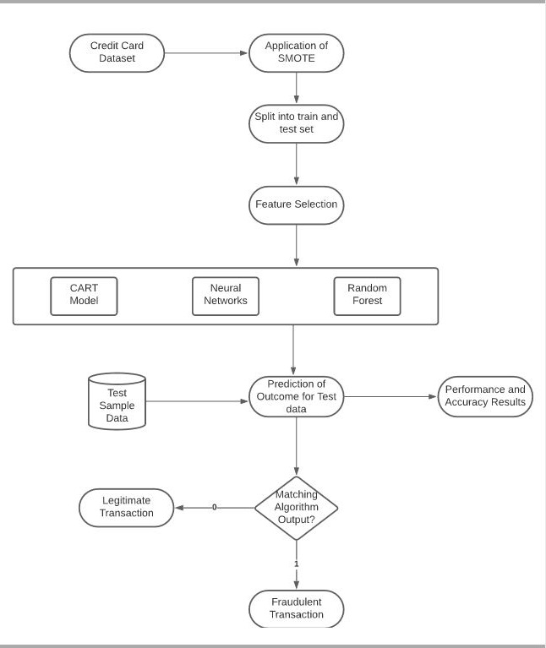
SYSTEM ARCHITECTURE
DIAGRAM
:

Slide 7
EXPERIMENTAL RESULTS:
DATASET USED:
LINK:
https://www.kaggle.com/mlg-ulb/creditcardfraud
DESCRIPTION:
The Credit Card Fraud Detection dataset contains transactions made by credit cards in September 2013 by European cardholders. This dataset presents transactions that occurred in two days, where we have 492 frauds out of 284,807 transactions. The dataset is highly unbalanced, the positive class (frauds) account for 0.172% of all transactions.
It contains only numerical input variables which are the result of a PCA transformation. Unfortunately, due to confidentiality issues, the original features and more background information about the data are not provided. Features V1, V2 … V28 are the principal components obtained with PCA; the only features which have not been transformed with PCA are 'Time' and 'Amount'.. Feature 'Class' is the response variable and it takes value 1
in case of fraud and 0 otherwise

Slide 8
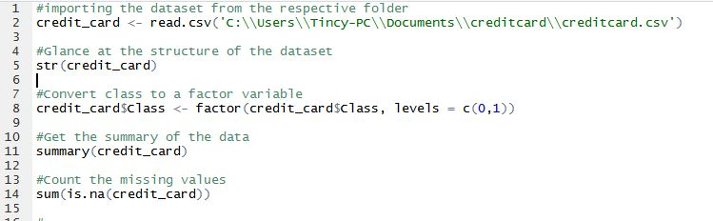
MODULE 1: PRE-PROCESSING MODULE:
Converting Class attribute to a factor variable with 2 levels 0 and 1.
0 indicating Legitimate transactions and
1 indicating Fraudulent transactions
CODE:

Slide 9
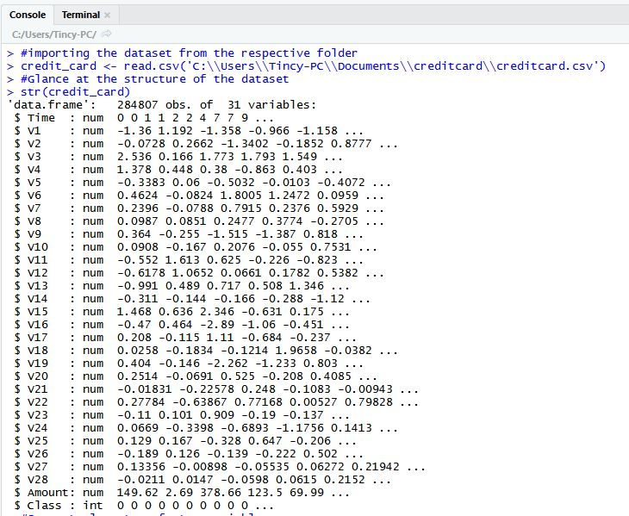
INPUT: Credit Card dataset with 2,84,807 transaction details.

Slide 10
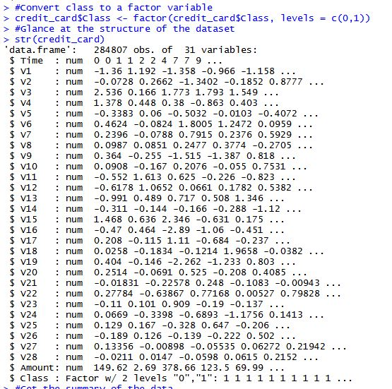
OUTPUT: Class attribute converted into factor variable

Slide 11

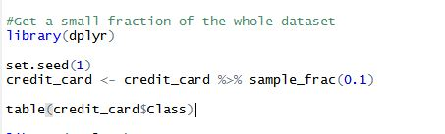
2. GETTING A SMALL FRACTION OF THE WHOLE DATASET
INPUT: ORIGINAL DATASET
OUTPUT: REDUCED DATASET
DISTRIBUTION OF ORIGINAL DATASET:
CODE TO GET A SMALL FRACTION OF THE DATASET:
A fraction of 0.1 (10% of the dataset) is taken into consideration to
decrease Execution time.

Slide 12
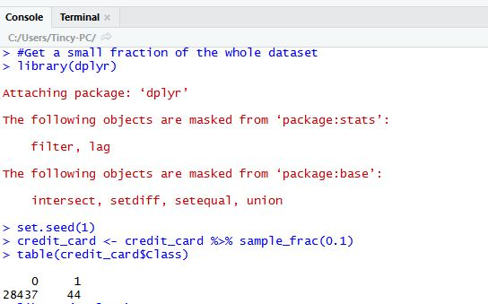
OUTPUT:
DISTRIBUTION OF THE OBTAINED SMALL FRACTION OF DATASET:
10% of the original dataset (with 28481 transactions) is our new dataset
using which we will build our model

Slide 13
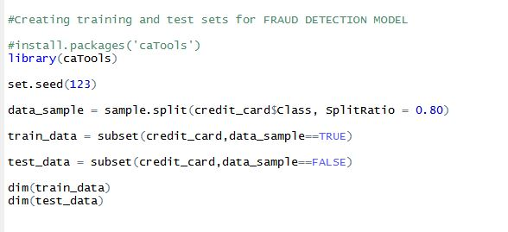
MODULE 2: SPLITTING INTO TRAINING AND TEST SETS:
INPUT: ENTIRE DATASET
OUTPUT: TRAINING SET AND TEST SET
CODE:
80% of dataset used as training set and remaining 20% used for testing.

Slide 14
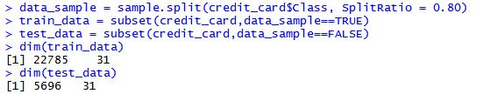
OUTPUT:
DISTRIBUTION OF TRAINING AND TEST SETS:

Slide 15
MODULE 3: APPLICATION OF SMOTE
ALGORITHM:
STEP 1: Choose a minority class input vector.
STEP 2: Find its k nearest neighbors (k neighbors is specified as an argument in the SMOTE() function)
STEP 3: Choose one of these neighbors and place a synthetic point anywhere on the line joining the point under consideration and its chosen neighbor.
INPUT: Original Dataset (imbalanced)
OUTPUT: SMOTE applied dataset with synthetic points added
(balanced dataset)

Slide 16
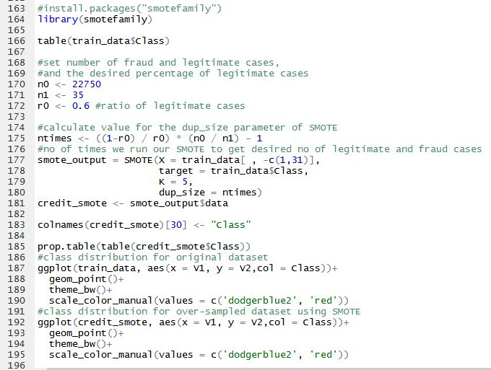
CODE:

Slide 17
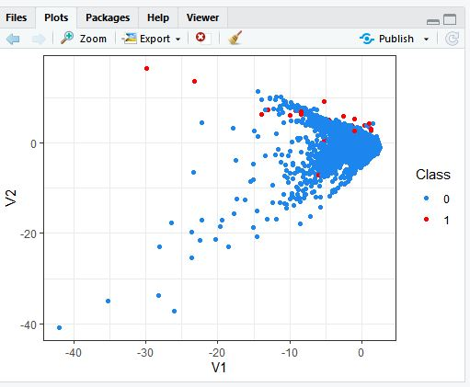
INPUT: Original Imbalanced Dataset

Slide 18
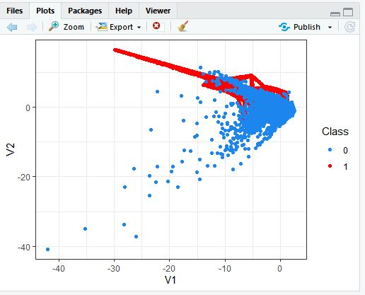

OUTPUT: DISTRIBUTION OF SMOTE APPLIED DATASET
60% of data -> legitimate cases
40% of data -> fraud cases

Slide 19
MODULE 4: BUILDING OF CART MODEL
Decision tree is a type of supervised learning algorithm (having a pre-defined target variable) that is mostly used in classification problems. It works for both categorical and continuous input and output variables.
In this technique, we split the population or sample into two or more homogeneous sets (or sub-populations) based on most significant splitter / differentiator in input variables.
WORKING OF DECISION TREE (ALGORITHM):
Decision trees use multiple algorithms to decide to split a node in two or more sub- nodes. The creation of sub-nodes increases the homogeneity of resultant sub-nodes.
In other words, we can say that purity of the node increases with respect to the target variable.
Decision tree splits the nodes on all available variables and then selects the split which results in most homogeneous sub-nodes.

Slide 20
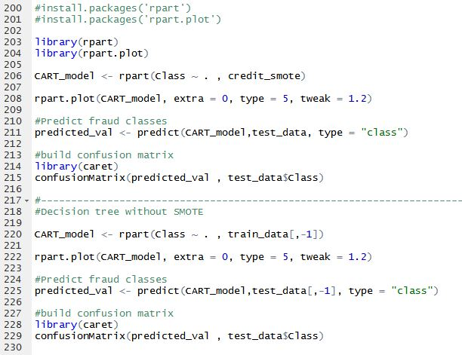
CODE:

Slide 21
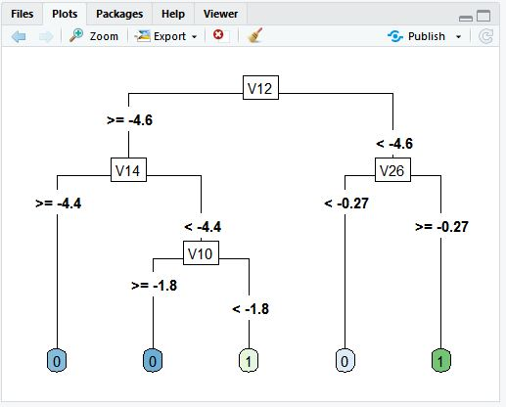
INPUT: Train data
OUTPUT: .CART Model

Slide 22
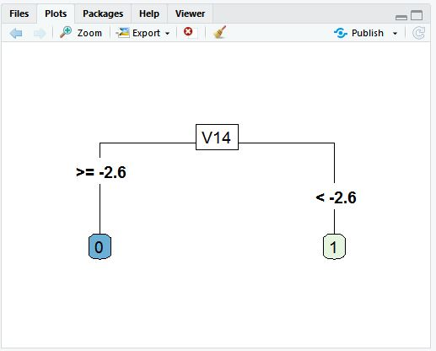
INPUT: SMOTE Applied Dataset
OUTPUT: .CART Model

Slide 23
MODULE 5: PREDICTION MODULE
INPUT: TEST DATA
OUTPUT: CONFUSION MATRIX, ACCURACY
CONFUSION MATRIX:
A confusion matrix is a table that is often used to describe the performance of a classification model (or "classifier") on a set of test data for which the true values are known.
ACCURACY:
Accuracy is the number of correctly predicted data points out of all the data points. More formally, it is defined as the number of true positives and true negatives divided by the number of true positives, true negatives, false positives, and false negatives.

Slide 24
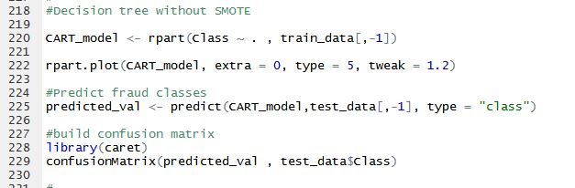
FINAL OUTPUT:
Constructing CART Model with original dataset:
CODE:

Slide 25
OUTPUT:
DECISION TREE OBTAINED FROM ORIGINAL DATASET :

Slide 26
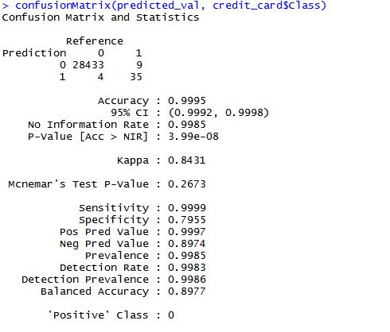
PREDICTING CLASS USING THE DECISION TREE BUILT:
TRUE POSITIVES: 28433
TRUE NEGATIVES: 35
Out of 44 fraudulent cases in test data, 35 were correctly classified
by the decision tree.

Slide 27
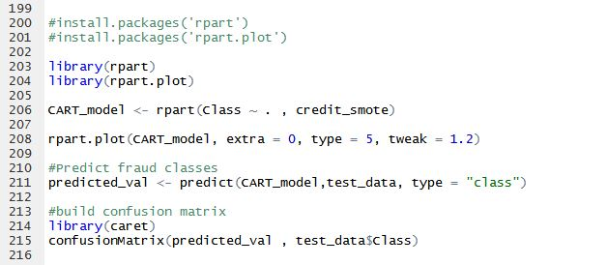
CONSTRUCTING CART MODEL FOR SMOTE APPLIED DATASET:
CODE:

Slide 28
CART MODEL BUILT AFTER APPLYING SMOTE TO THE DATASET.:

Slide 29
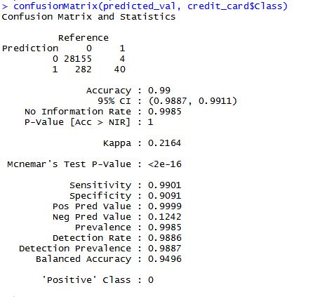
PREDICTING CLASS USING THE CART MODEL BUILT:
TRUE POSITIVES: 28155
TRUE NEGATIVES: 40
Out of 44 fraudulent cases in Data, 40 were correctly classified as
FRAUDULENT by our model..
Hence model built using SMOTE applied dataset gives us better results.

Slide 30
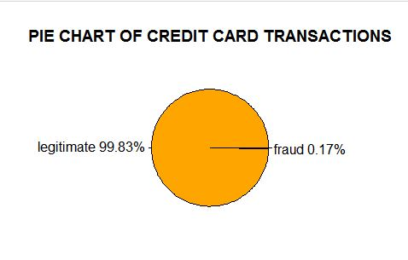
OUTPUT ( ANALYTICAL ABLATION STUDY ) :
Distribution of legitimate and fraud cases in the dataset
Imbalanced data sets are a special case for classification problem where the class distribution is not uniform among the classes.
Hence, credit card dataset is an imbalanced one.

Slide 31
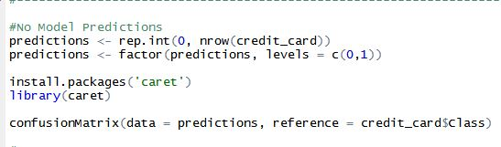
NO MODEL PREDICTIONS:
Since our dataset is a highly imbalanced one and has 99.83%
Legitimate cases and only 0.17% fraud cases, even if we predict all transactions
to be legitimate, rate of error would be minimal and still we would be able to
achieve 99% accuracy as misclassifications would have happened only in 1% of
the total data where instead of fraudulent, the result would have been
misclassified as legitimate.
NO MODEL PREDICTIONS (CODE):

Slide 32
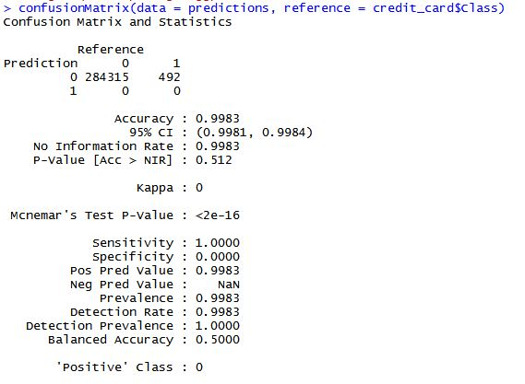
OUTPUT:
Owing to such imbalance in data, an algorithm that does not do any
feature analysis and predicts all the transactions as non-frauds will also
achieve an accuracy of 99.83%.
Therefore, accuracy is not a correct measure of efficiency in our case.
We need some other standard of correctness while classifying transactions
as fraud or non-fraud.

Slide 33
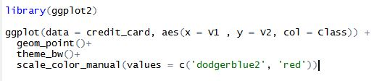
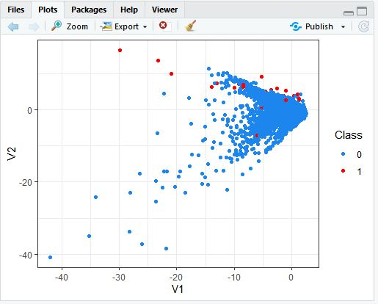
DISTRIBUTION OF CLASSES BETWEEN V1 AND V2:
CODE:
OUTPUT

Slide 34
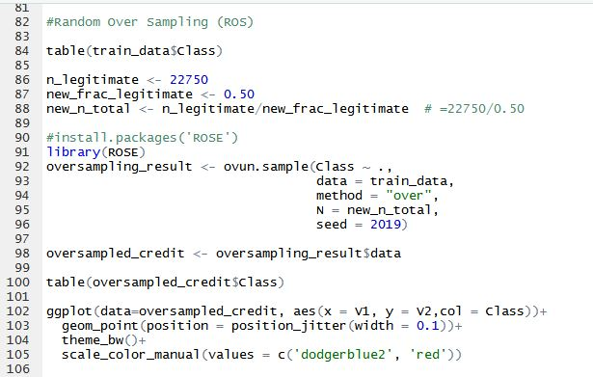
BALANCING THE IMBALANCED DATASET:
USING RANDOM OVER-SAMPLING:
Random oversampling involves randomly duplicating examples
from the minority class and adding them to the training dataset.

Slide 35
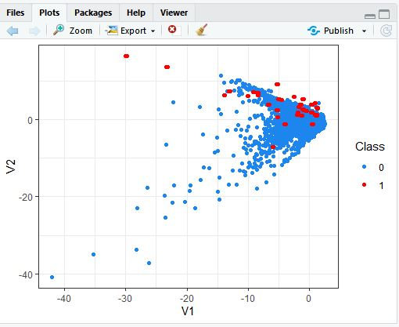
OUTPUT:
Duplicates that are created can be visualized by adding jitter.
Adding duplicate copies of existing data points doesn’t provide vast improvements
in our case. Hence, we try Random Under Sampling.

Slide 36
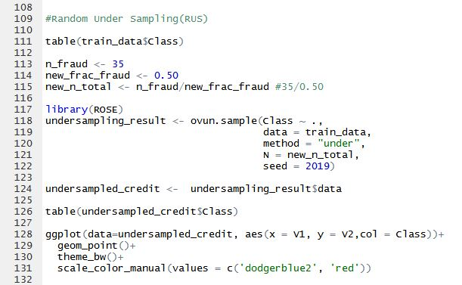
USING RANDOM UNDER SAMPLING:
Random under-sampling involves randomly selecting examples from
the majority class and deleting them from the training dataset. In the random
under-sampling, the majority class instances are discarded at random until a
more balanced distribution is reached.

Slide 37
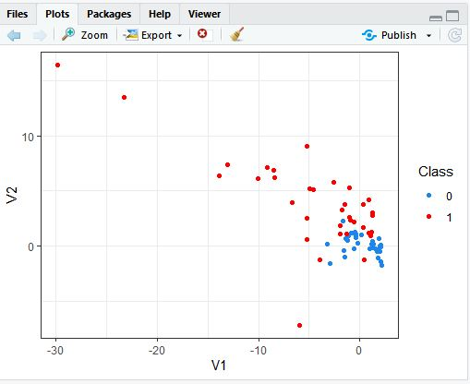
OUTPUT:
The problem with Random Under Sampling is that we end up losing
lot of data. Now we will perform both ROS and RUS together.

Slide 38
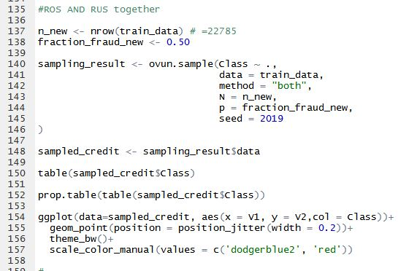
USING BOTH ROS AND RUS TOGETHER:
CODE:

Slide 39
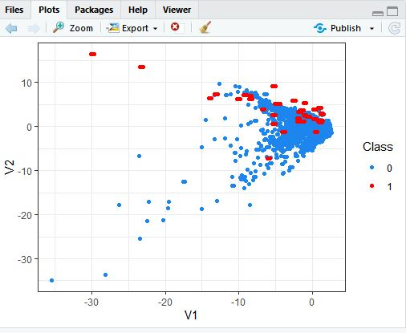
OUTPUT:

Slide 40
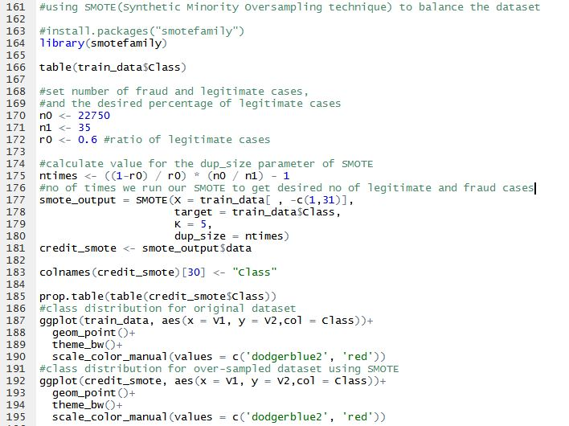
USING SMOTE:

Slide 41
SMOTE: Synthetic Minority Over-sampling Technique.” SMOTE
works by selecting examples that are close in the feature space, drawing a line
between the examples in the feature space and drawing a new sample at a
point along that line. SMOTE adds synthetic points to our dataset instead of
creating duplicate copies of existing data points.
OUTPUT:

Slide 42
PERFORMANCE METRICES:

Slide 43
SENSITIVITY:
Sensitivity is a measure of the proportion of actual positive cases that got predicted as positive (or true positive).
Mathematically, sensitivity can be calculated as the following:
Sensitivity = (True Positive)/(True Positive + False Negative)
SPECIFICITY:
Specificity is defined as the proportion of actual negatives, which got predicted as the negative (or true negative).
Mathematically, specificity can be calculated as the following:
Specificity = (True Negative)/(True Negative + False Positive)
ACCURACY:
It is defined as the number of true positives and true negatives divided by the number of true positives, true negatives, false positives, and false negatives.
Accuracy=A+B/C+D
Where, A=True Positive B=True Negative C=Positive D=Negative

Slide 44
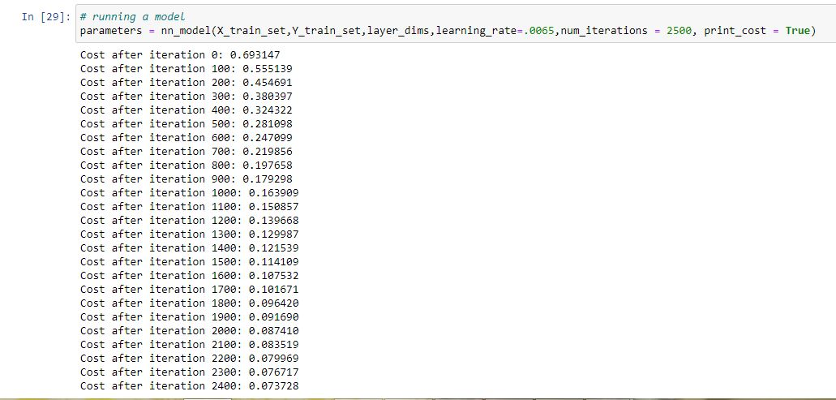
APPLICATION OF NEURAL NETWORKS TO THE DATASET:
There are different layers in a neural network that focus on different parameters to make a decision whether a transaction is ‘fraud’ or ‘non-fraud.’
PREDICTION RESULTS:

Slide 45
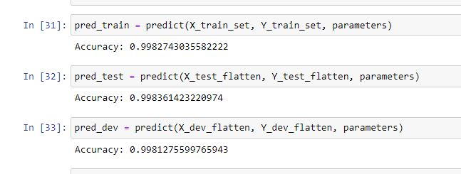
RUNNING THE MODEL FOR 2500 ITERATIONS, WE GET :

Slide 46
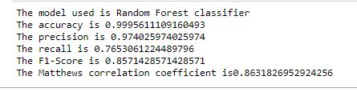
APPLICATION OF RANDOM FOREST ALGORITHM TO THE
DATASET:
Random forest is a tree based algorithm which involves building several trees and combining with the output to improve generalization ability of the model. This method of combining trees is known as an ensemble method. Ensembling is nothing but a combination of weak learners (individual trees) to produce a strong learner
PERFORMANCE METRICS:

Slide 47

CONCLUSION:
Thus, Machine Learning plays an important role in Credit Card Fraud
Detection. Machine learning models are able to learn from patterns of normal behavior. They are very fast to adapt to changes in that normal behavior and can quickly identify patterns of fraud transactions.

Slide 48
REFERENCES:
International Journal of Applied Engineering Research ISSN 0973-4562 Volume 13, Number 24 (2018) pp. 16819-16824 © Research India Publications. http://www.ripublication.com 16819 Machine Learning For Credit Card Fraud Detection System
https://www.ripublication.com/ijaer18/ijaerv13n24_18.pdf

